Slide 1

The project "Direction → Development of key competences" with the number 2022-1-PL01-KA121-SCH-000068475 co-financed by the European Union implemented at the Continuing Education School Complex in Rzeszów from 01.06.2022 to 31.08.2023. Project co-financing from the EU: EUR 88,715.00.

Slide 2
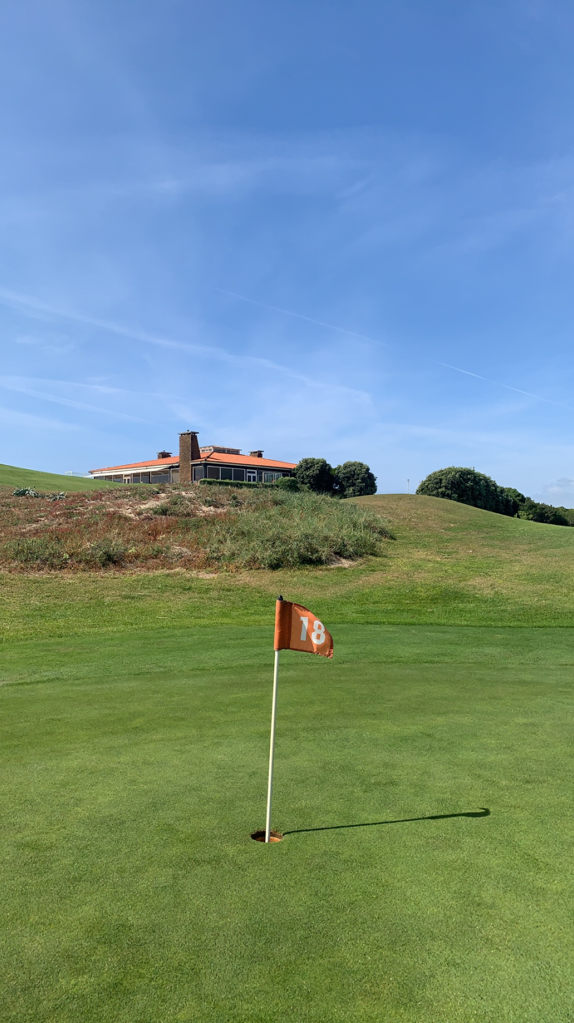
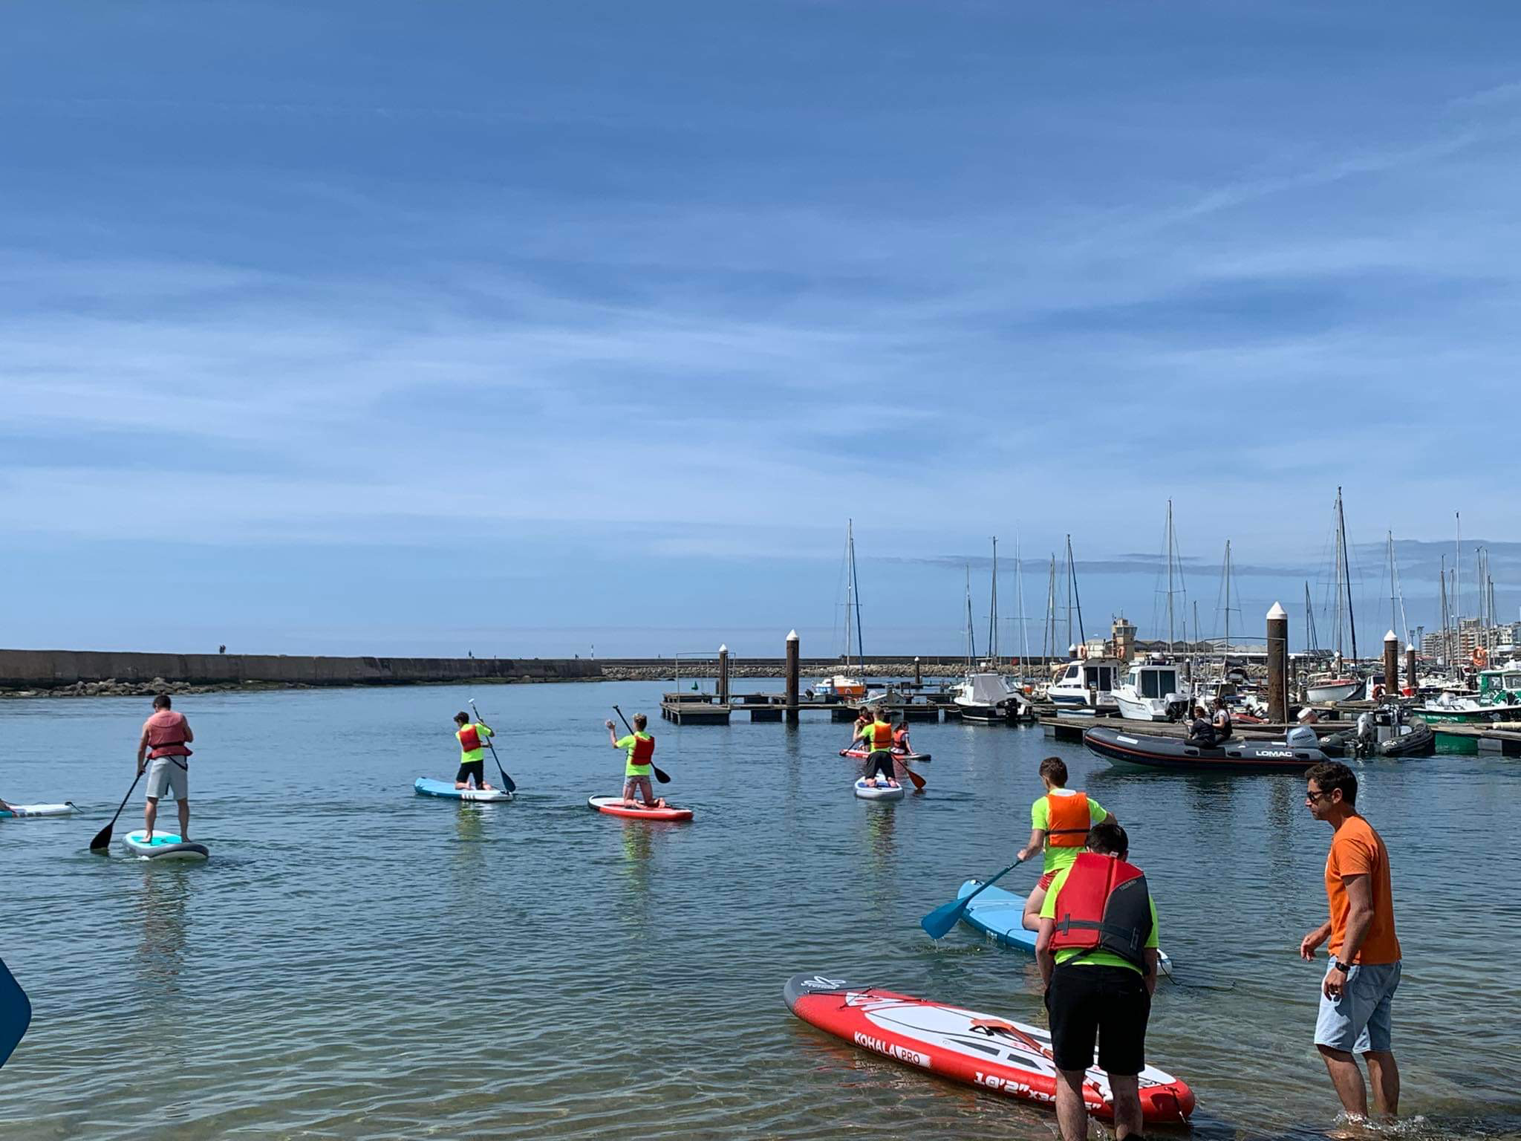
Presentation about golf and surfing in Portugal

Slide 3
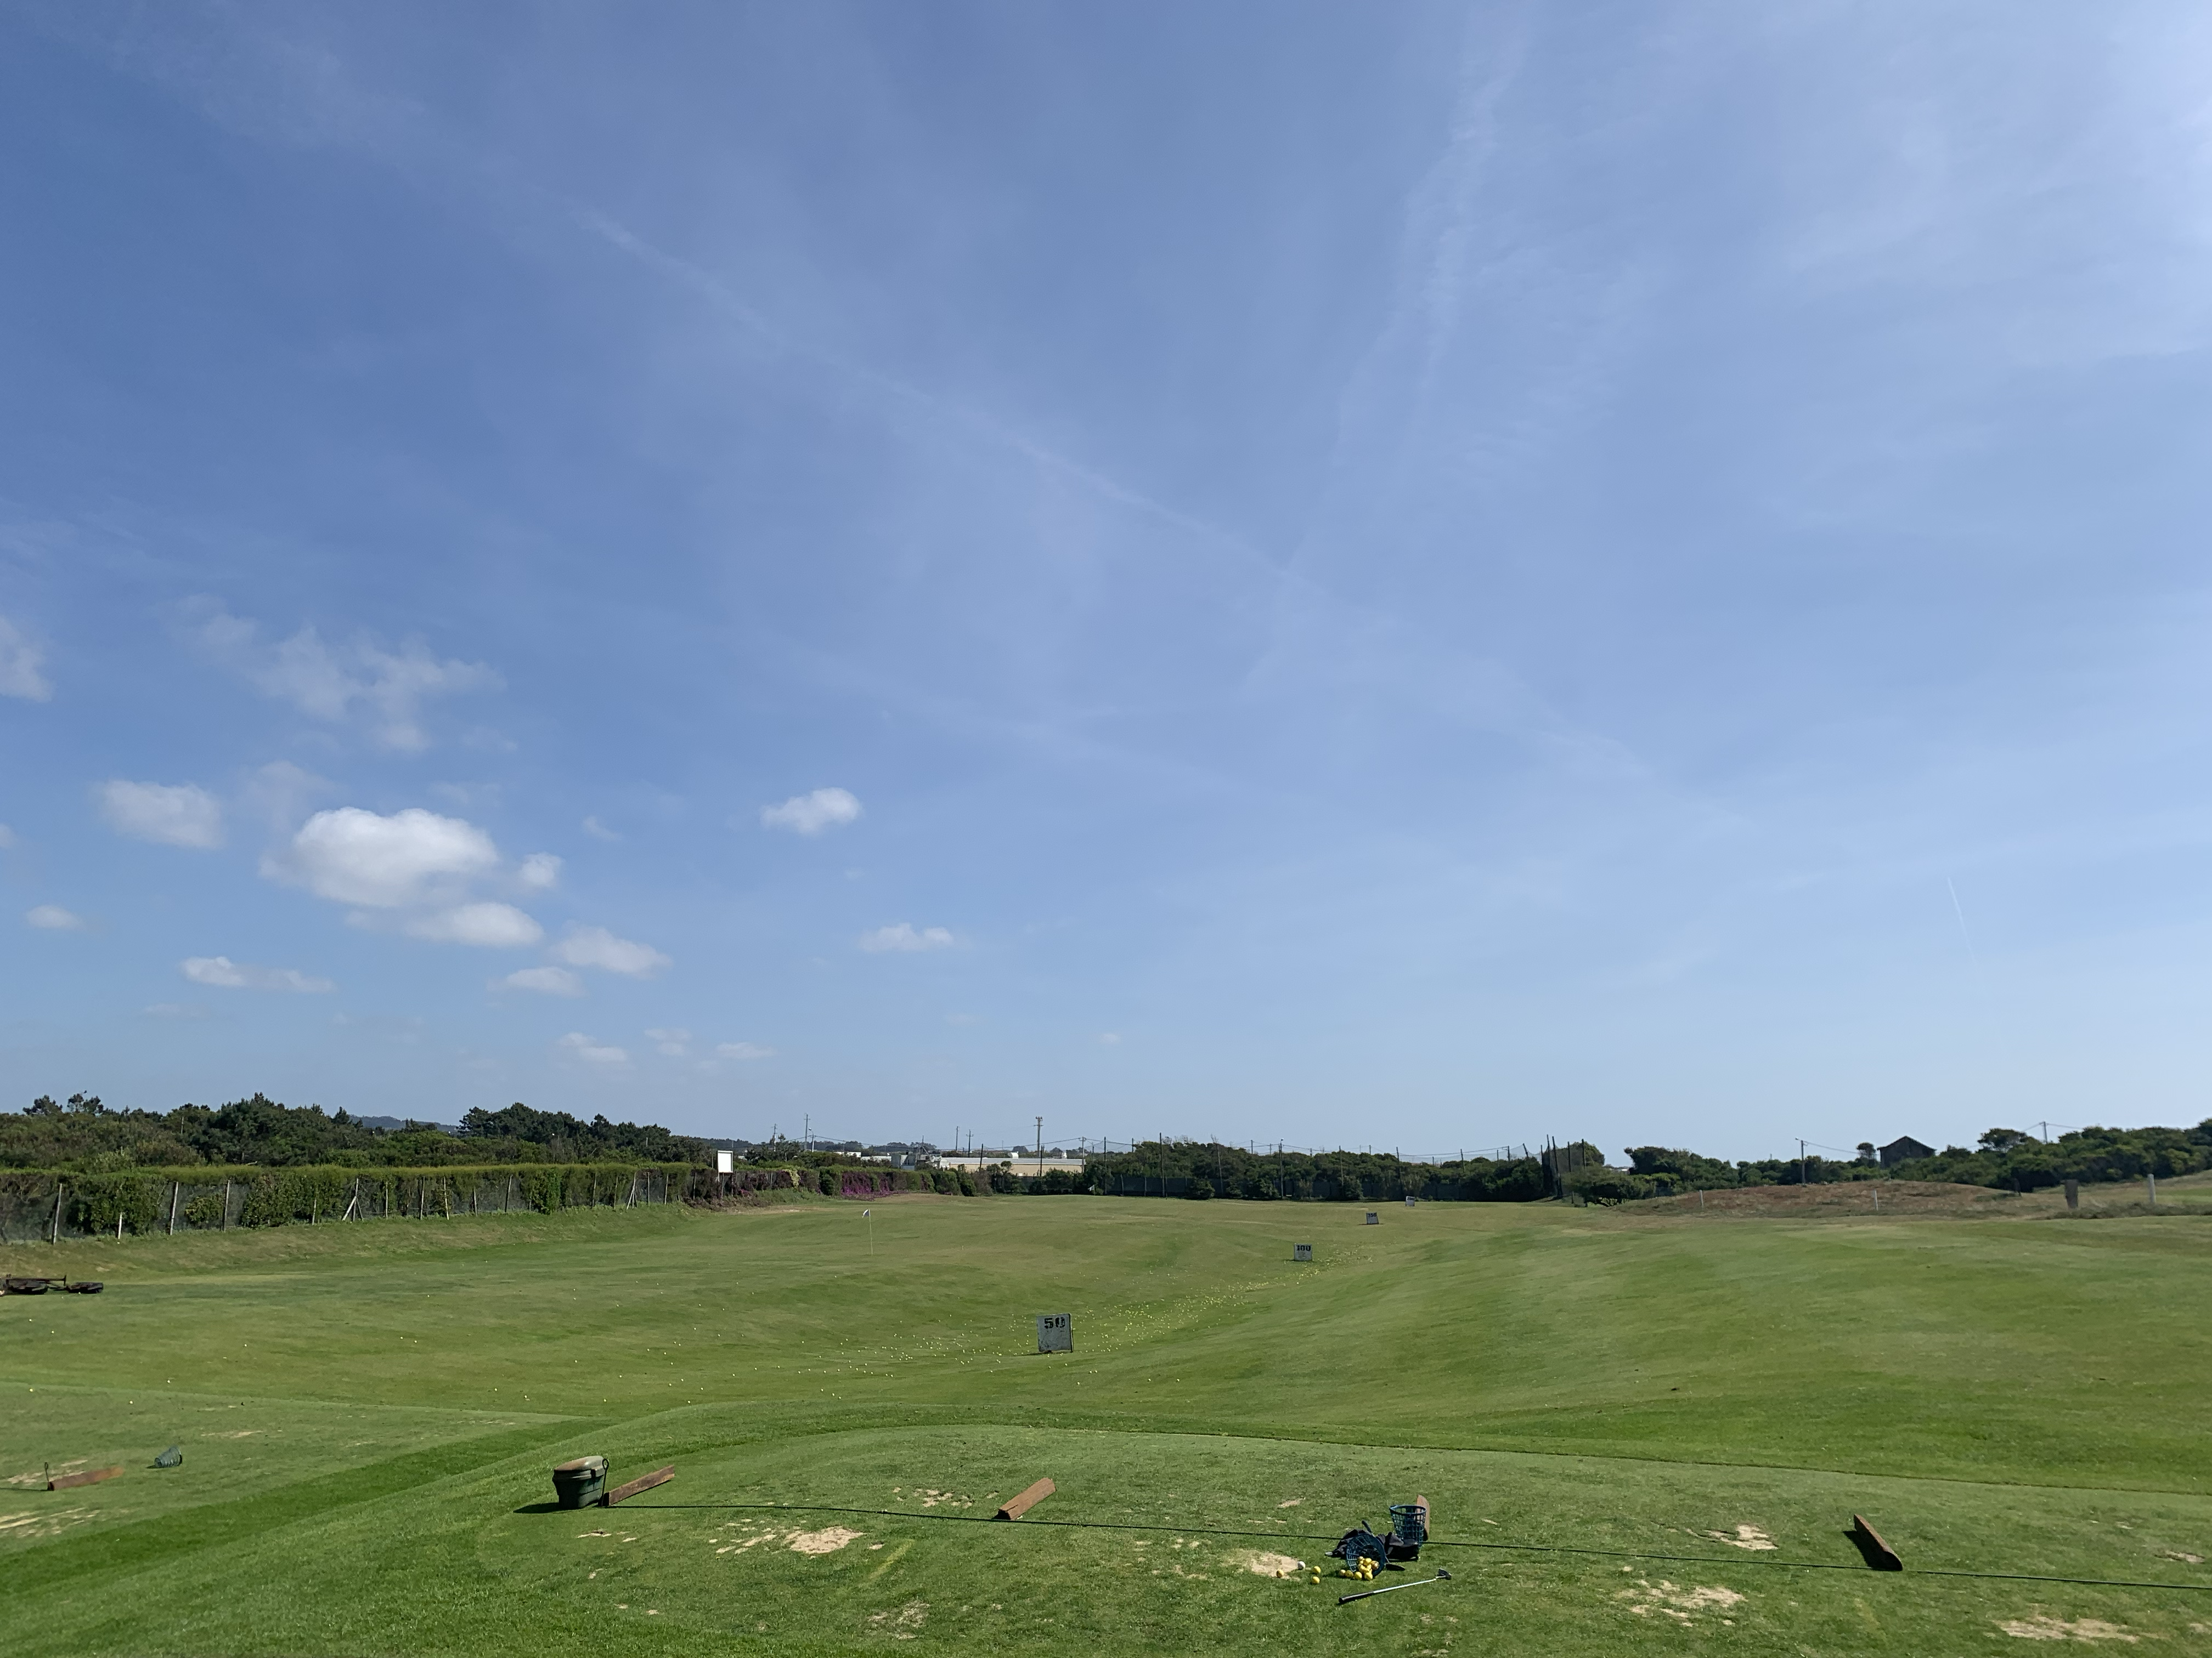
Golf in Estela 20.04.2023
Last Thursday we went to Estela where there is a golf course. We were taught everything from scratch by a patient and understanding instructor, thanks to whom we found out that it is not as easy as it seems but with each shot we were getting better and better and everyone had fun.

Slide 4
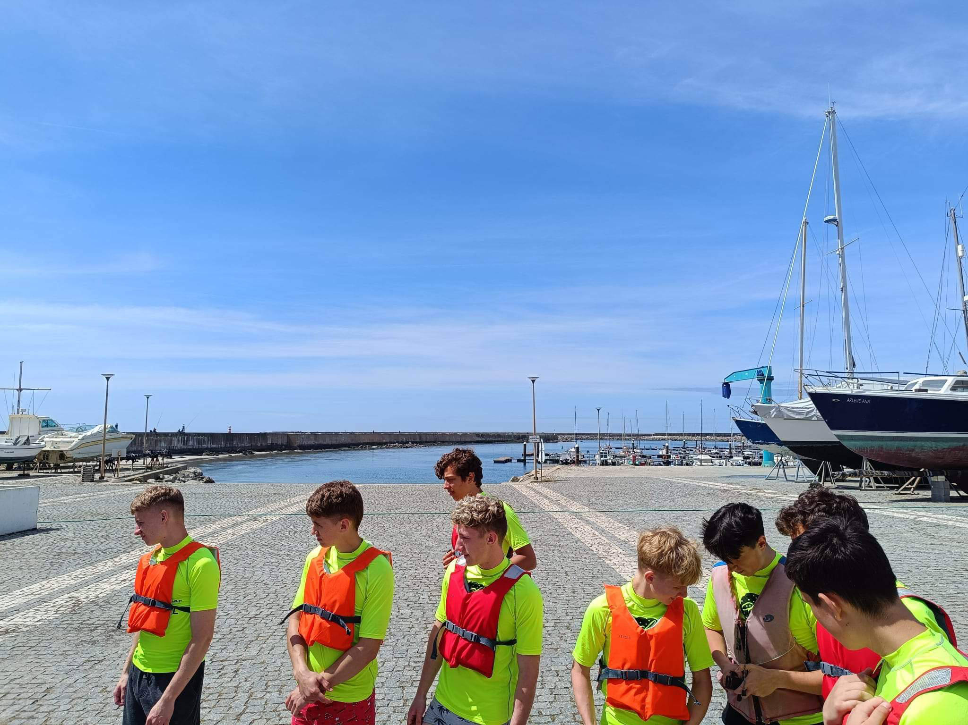
A few information about surfing
On Monday we had a surfing lesson in Povóa de Varzim. First, we had a short instruction how to behave on a board in order to stay safe. Then, dressed as profesional surfers we picked up surfboards and off we went!

Slide 5
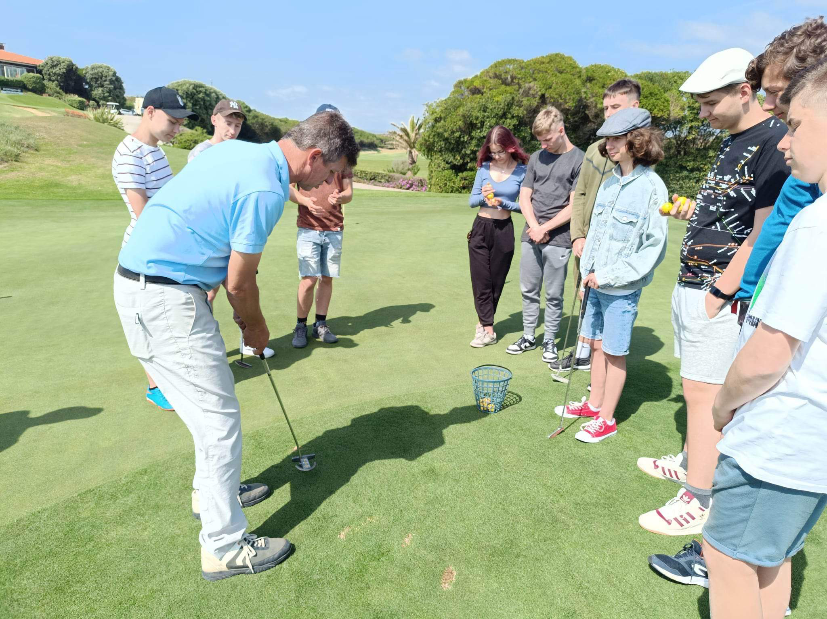
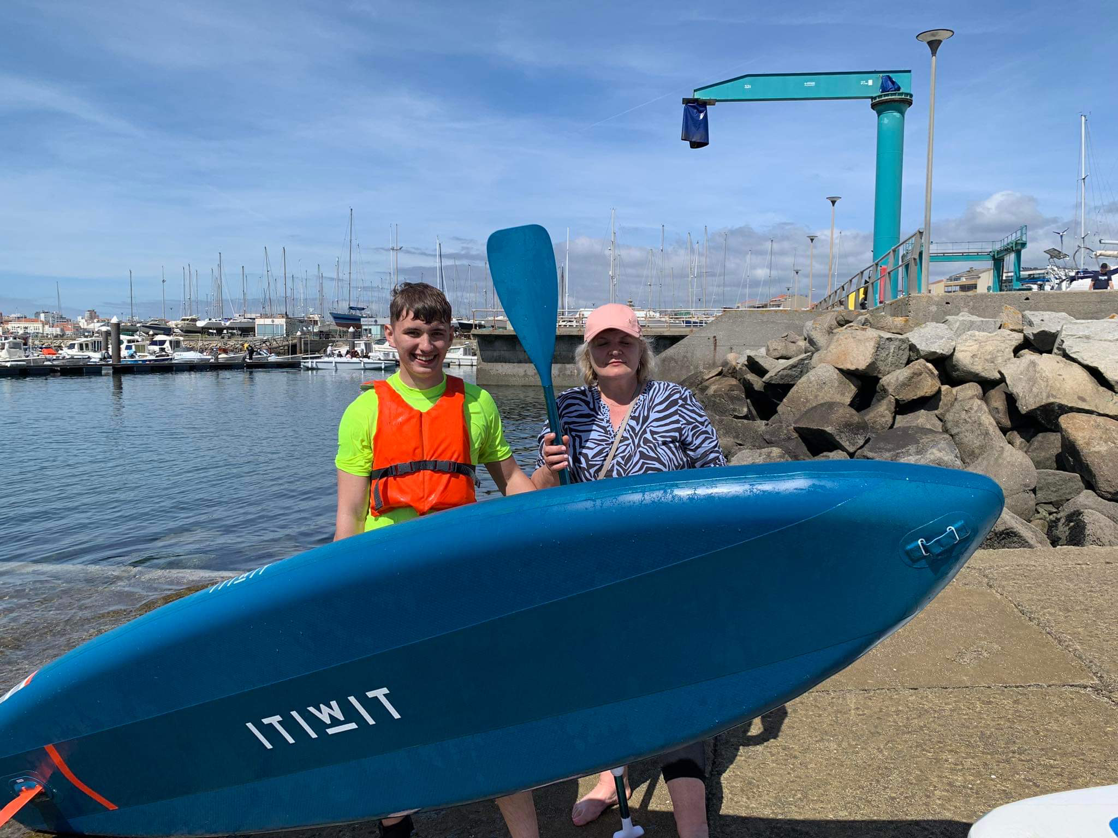
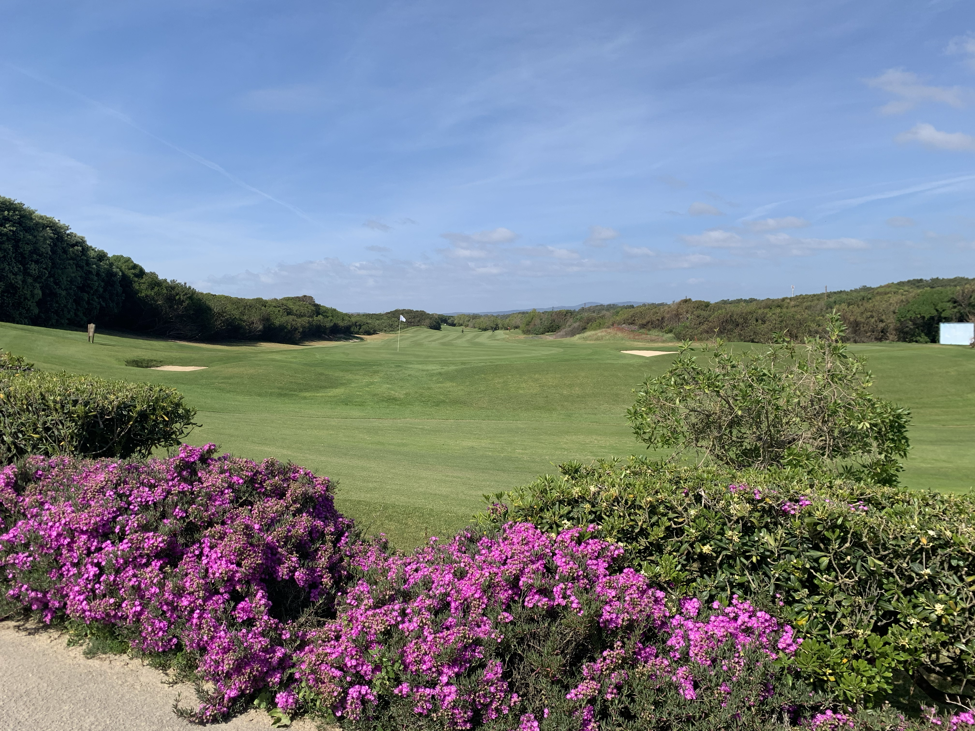
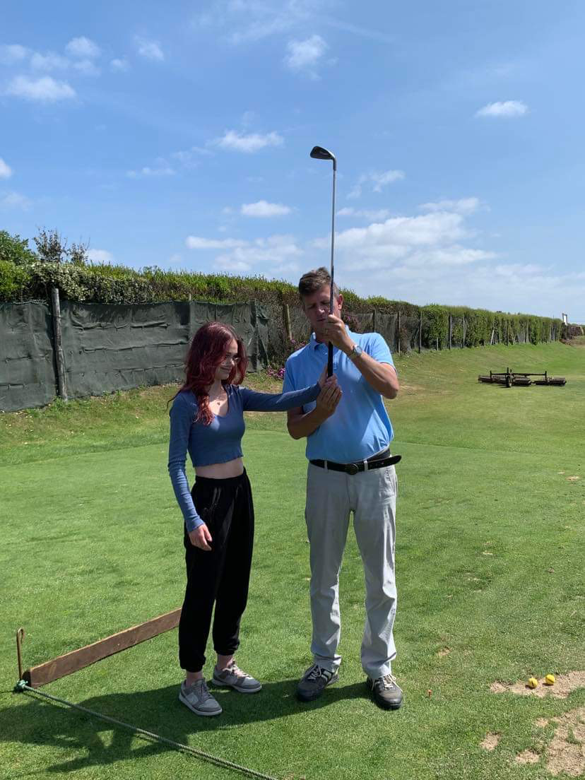
A few photos from golf and surfing lessons

Slide 6
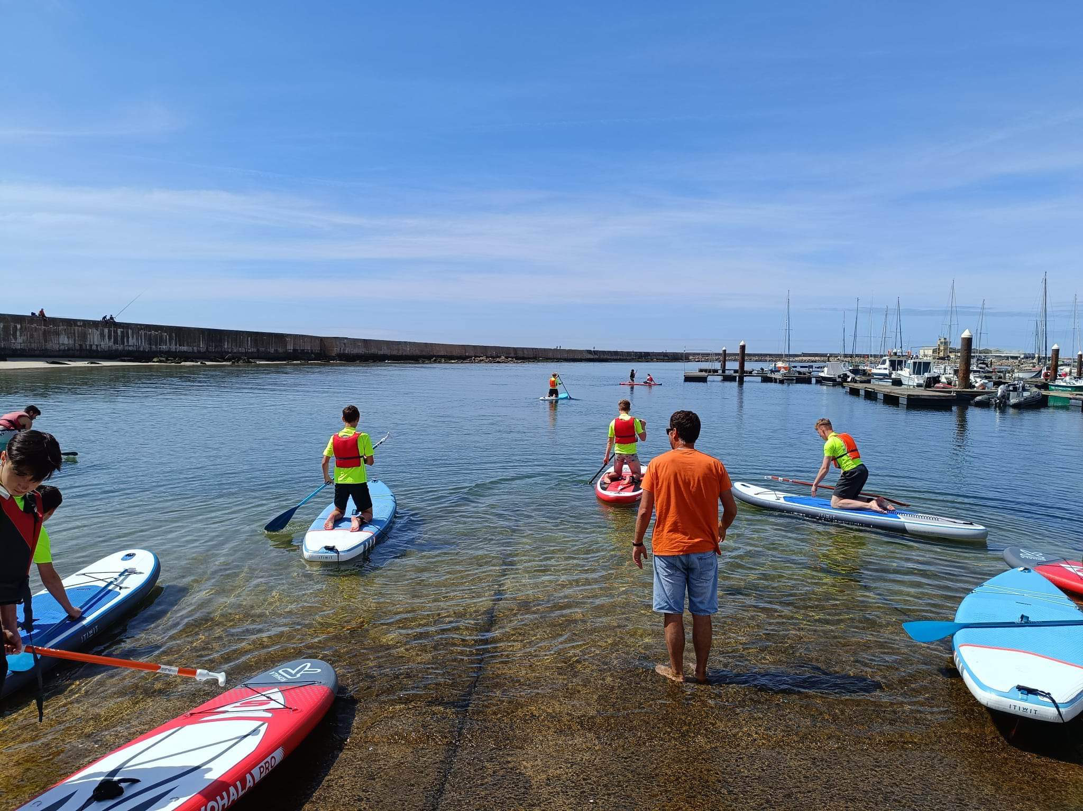
Surfing competition
After the surfing lesson our instructor challenged us to have a race on our boards. It wasn't without some stumbles and falls but everyone managed to swim to the finish line. It was an amazing adventure for us all!

Slide 7
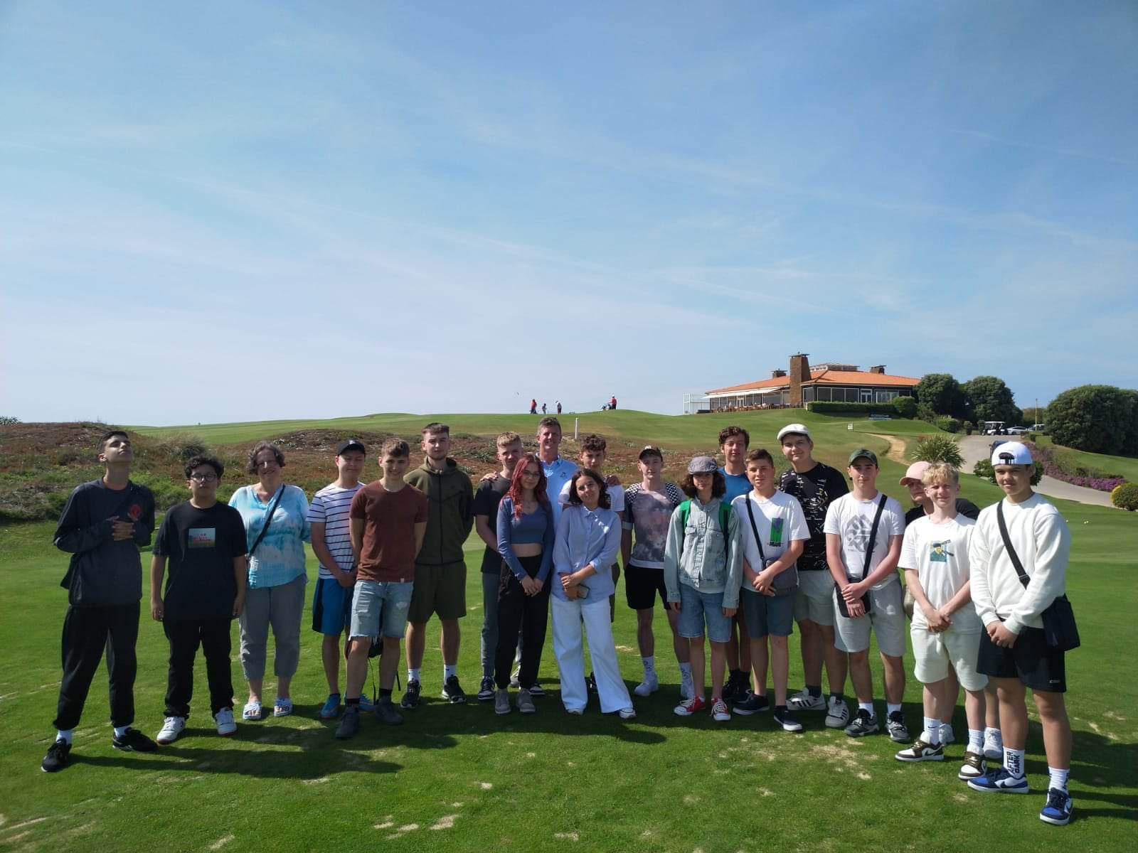
Thank you for your attention!

